Slide 1

Scooby-Doo Watchability
Juliana Broussard, Sarah Huang, & Connor Saxon

Slide 2
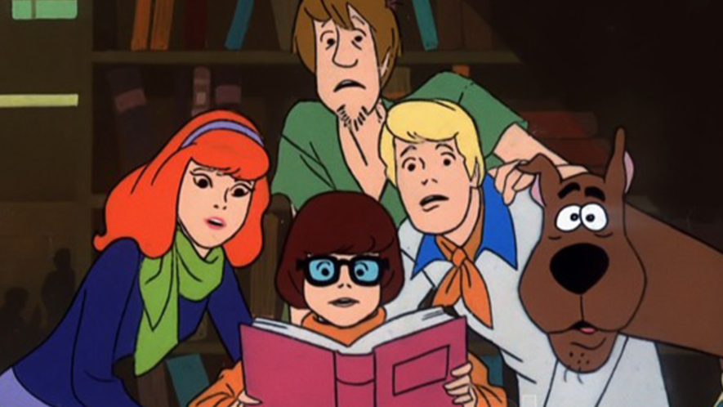
PROBLEM & BACKGROUND

Slide 3
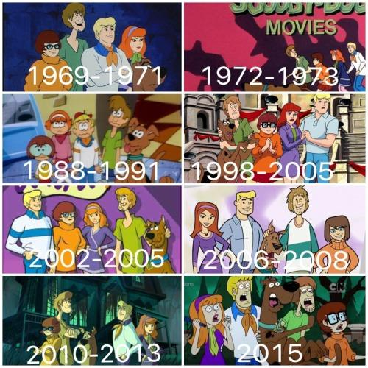
BACKGROUND
Debuted in September 3, 1969, Scooby-Doo is a beloved childhood show with over 600 episodes and movies
Follows the adventures of Scooby, Shaggy, Fred, Daphne, and Velma as they try to uncover mysteries and capture “monsters”

Slide 4

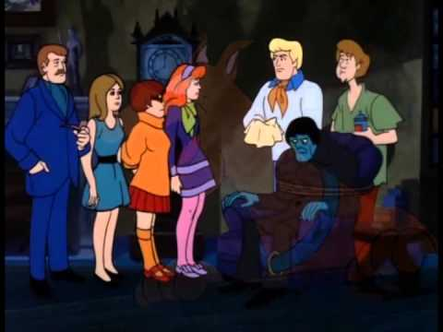
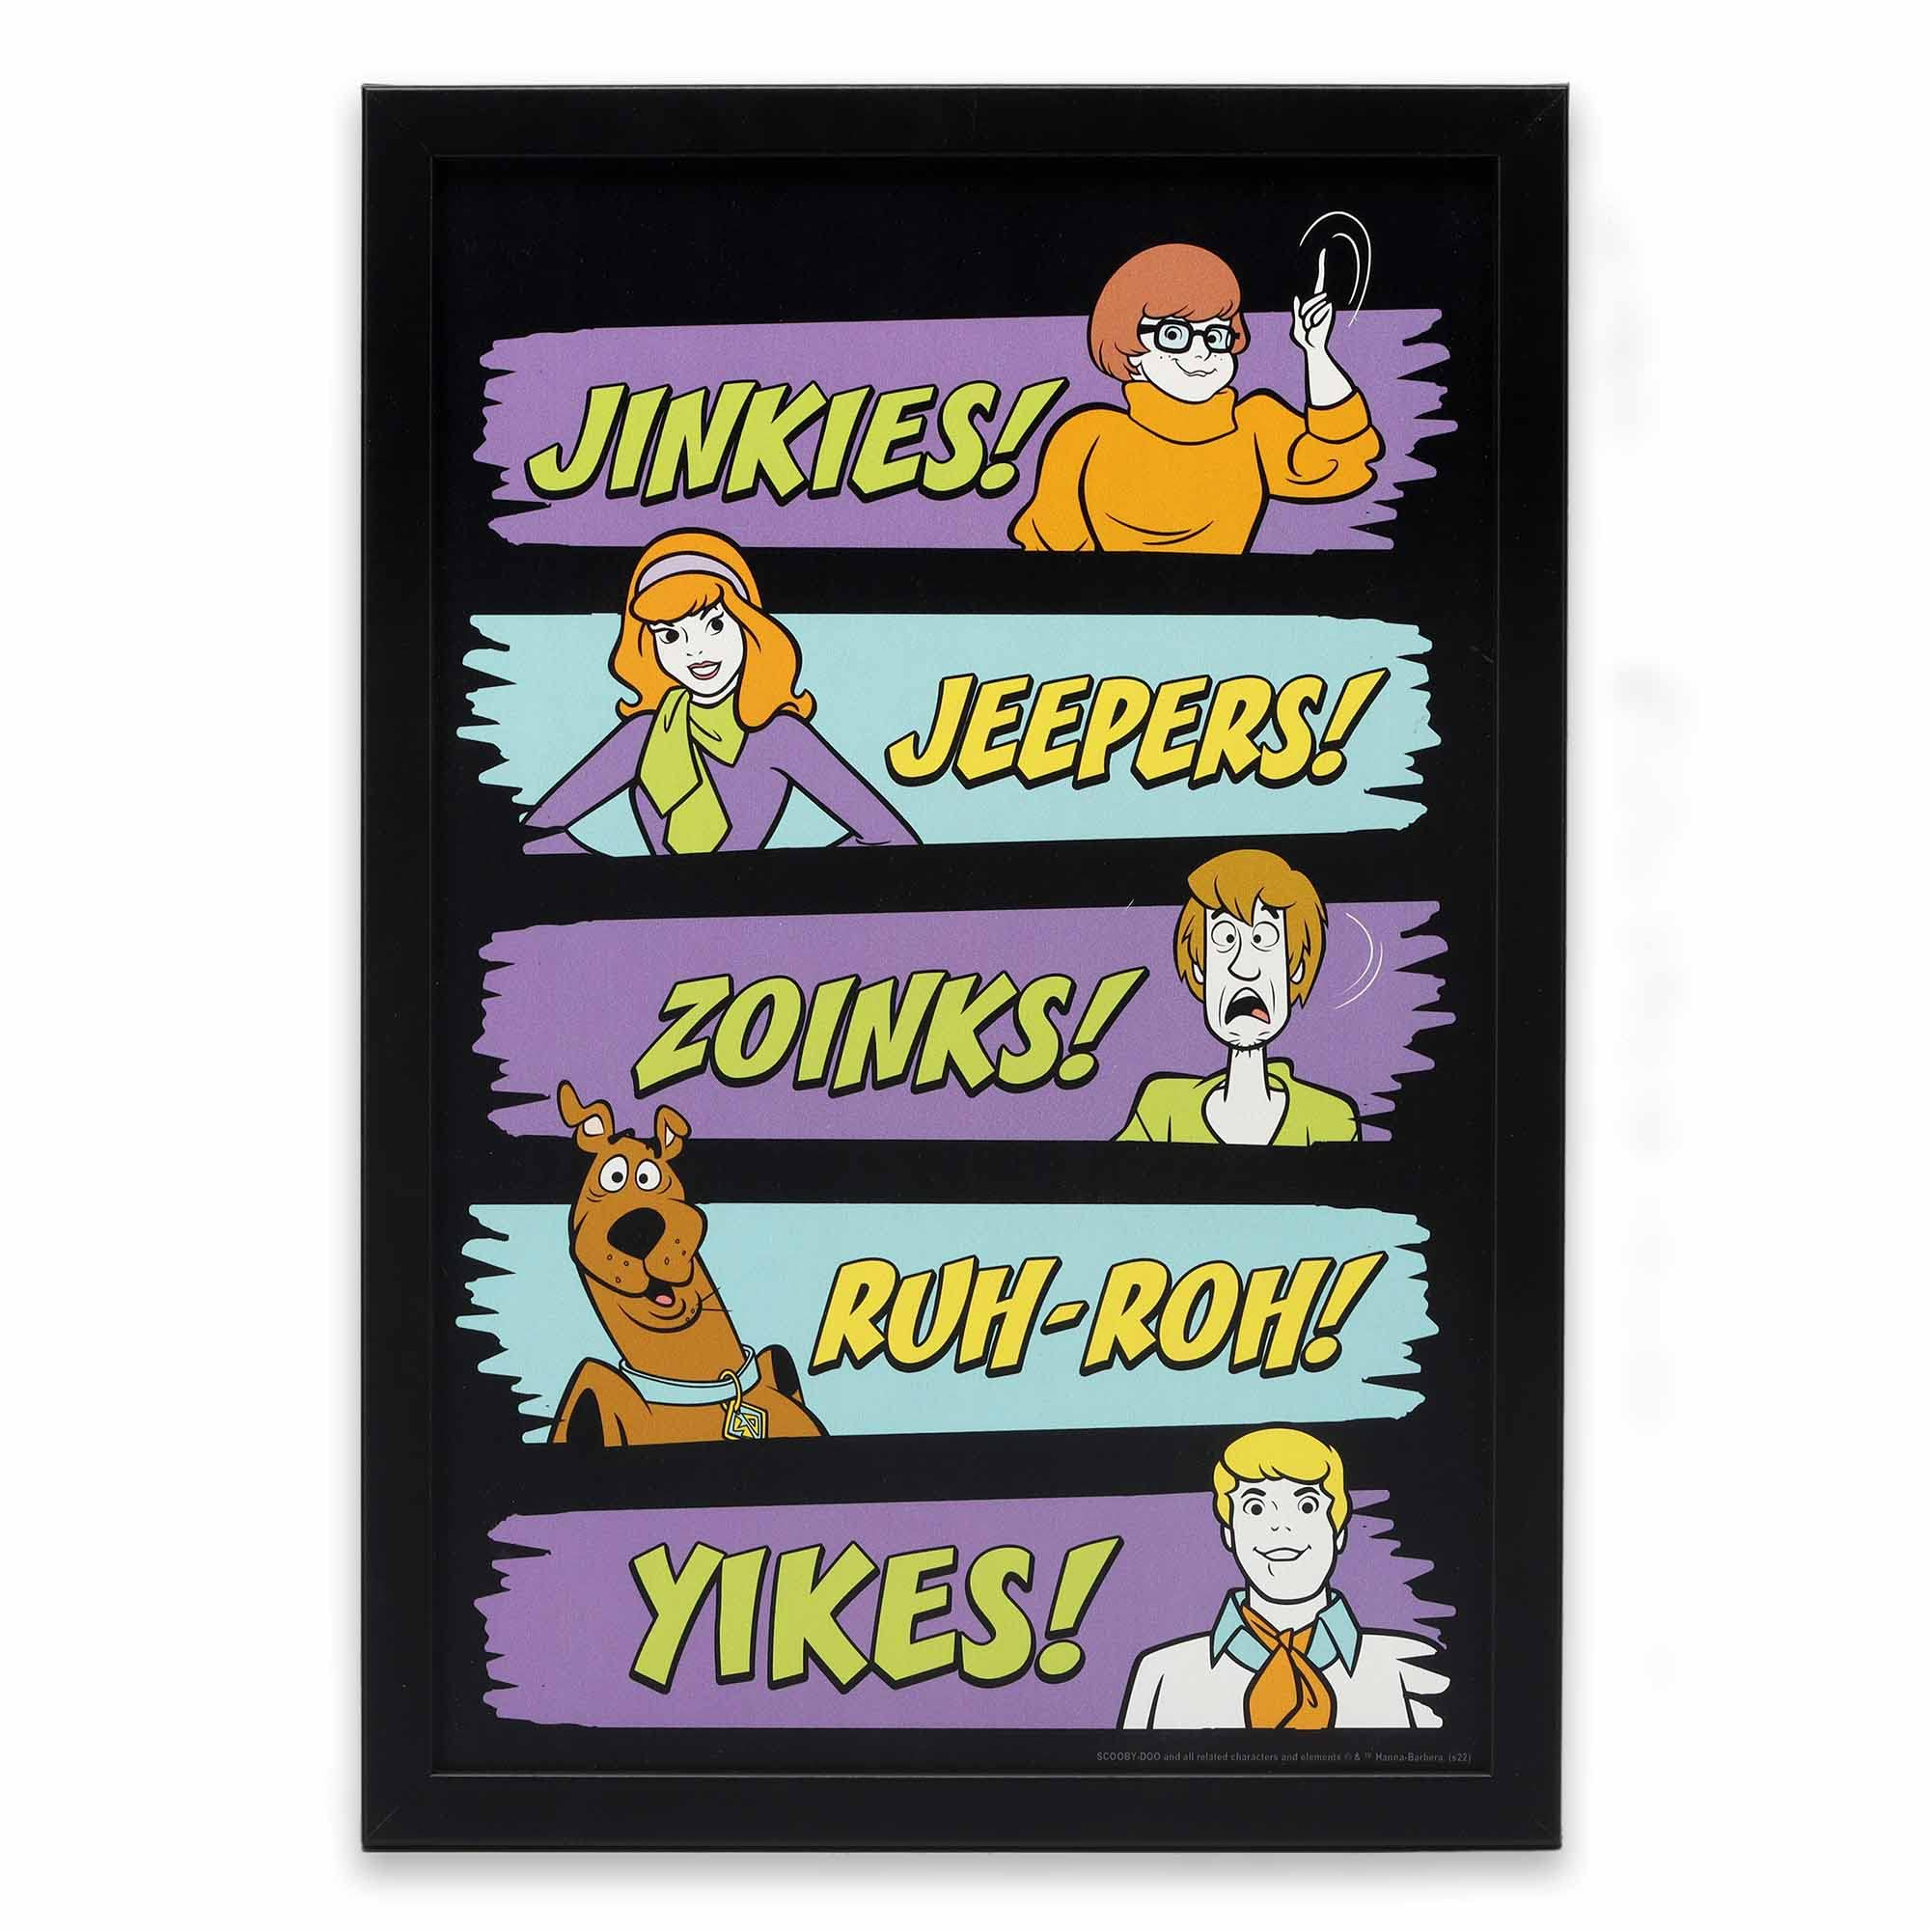
PROBLEM
Regression
Predict the overall watchability of an episode or movie based on predicting the IMDb score
IMDb score - An average of user-submitted and critic ratings out of ten
This score will depend on two other factors of regression:
How many times specific phrases are spoken per episode/movie
Who caught the monster in each episode/movie
A character's performance in an episode could impact the IMDb score

Slide 5
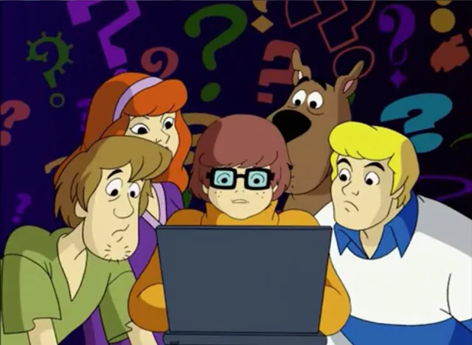
DATASET VISUALIZATION

Slide 6
DATASET
“Scooby-Doo Complete” by plummye on Kaggle
74 features including but not limited to:
Unmasking frequency
Captured frequency
Snacks frequency
Jeepers counter
Zoinks counter
Voice actors
IMDb score

Slide 7
CHOOSING DATA
We only used:
imdb
caught.fred
caught.daphne
caught.velma
caught.shaggy
caught.scooby
my.glasses
jeepers
zoinks
jinkies
series.name
run.time

Slide 8
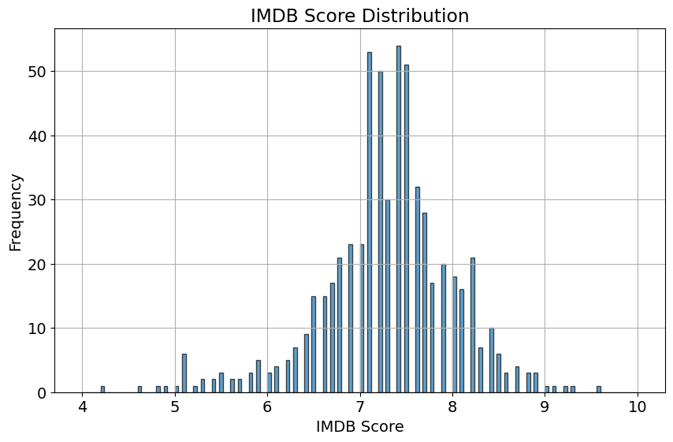

Slide 9
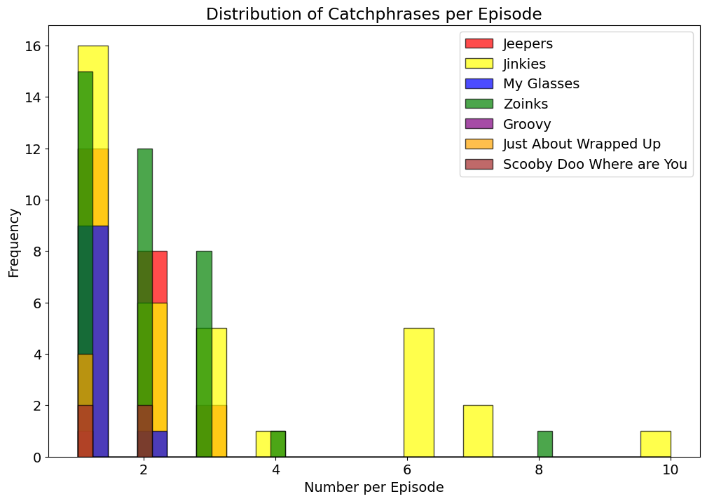

Slide 10
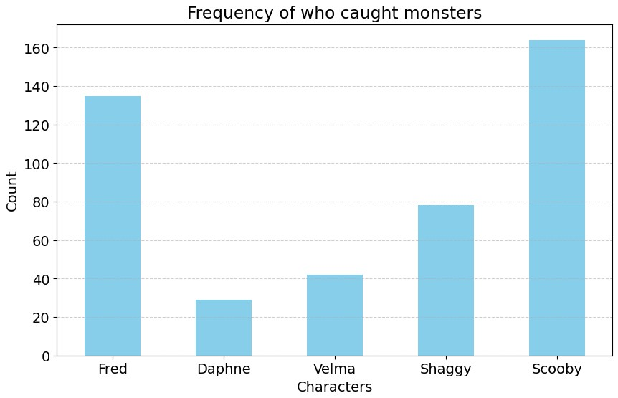

Slide 11
TRANSFORMING & CLEANING DATA
Dropna() used on data to discard NAN values
Problem: Dropping all rows with a single NAN significantly reduces the amount of data to train with
Solution: Work on columns individually to convert NAN to usable data
Convert boolean strings to integers and convert “NULL” values to 0
Encode series name
Convert IMDb ratings into three classes: ‘Low’, ‘Medium’, and ‘High’
Low: 0-5, Medium: 5-7, and high: 7-10
Convert caught.characterName from string literal to “TRUE/FALSE”

Slide 12
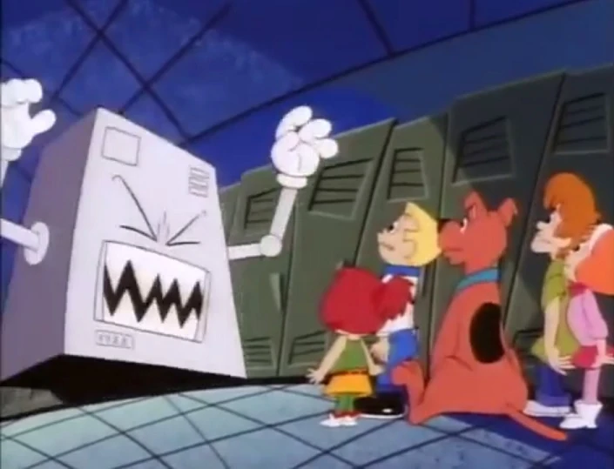
MACHINE
LEARNING APPROACHES

Slide 13
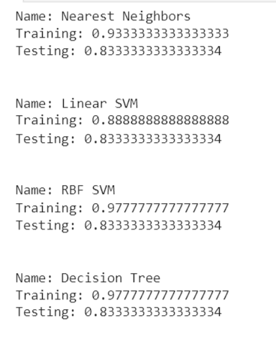
CHOOSING ML APPROACHES
Use Dr. Schuman’s all-classifiers Python script to narrow down ML approaches
In the end, we chose the following approaches because of their high accuracy on training and testing data:
Decision Trees
Nearest Neighbors
RBF SVM
Random Forest Regression

Slide 14
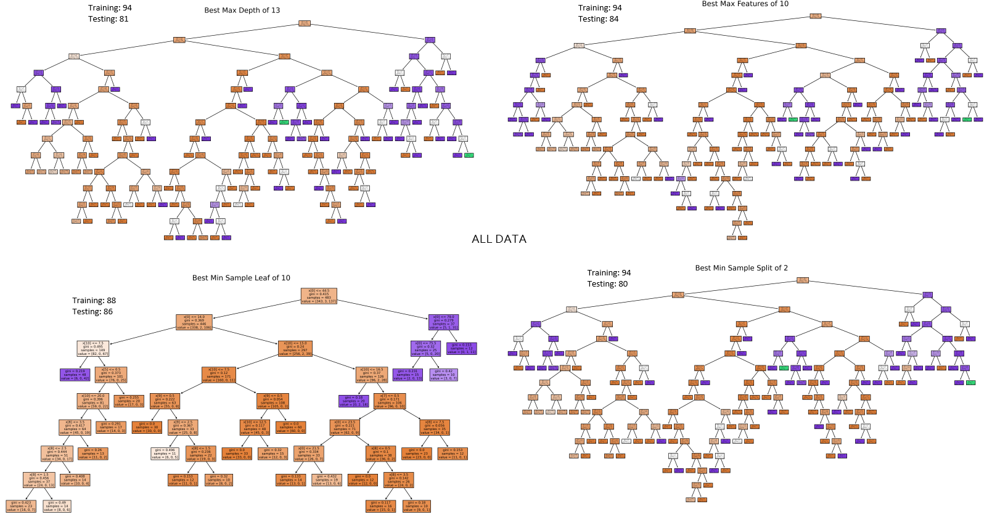
DECISION TREES
Hyperparameters: Maximum Depth, Maximum Features, Minimum Sample Leaf, Minimum Sample Split
Criterion: Gini
Tested on all data, only catchphrases, & only caught

Slide 15
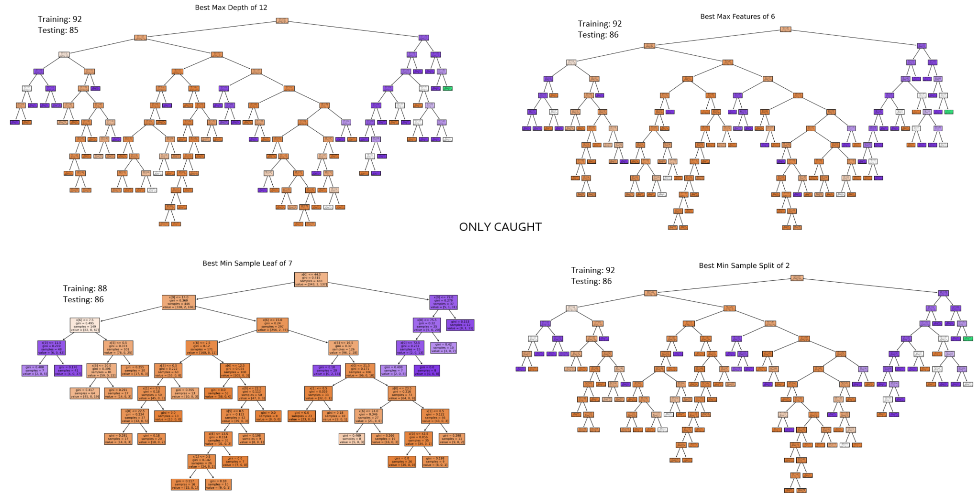
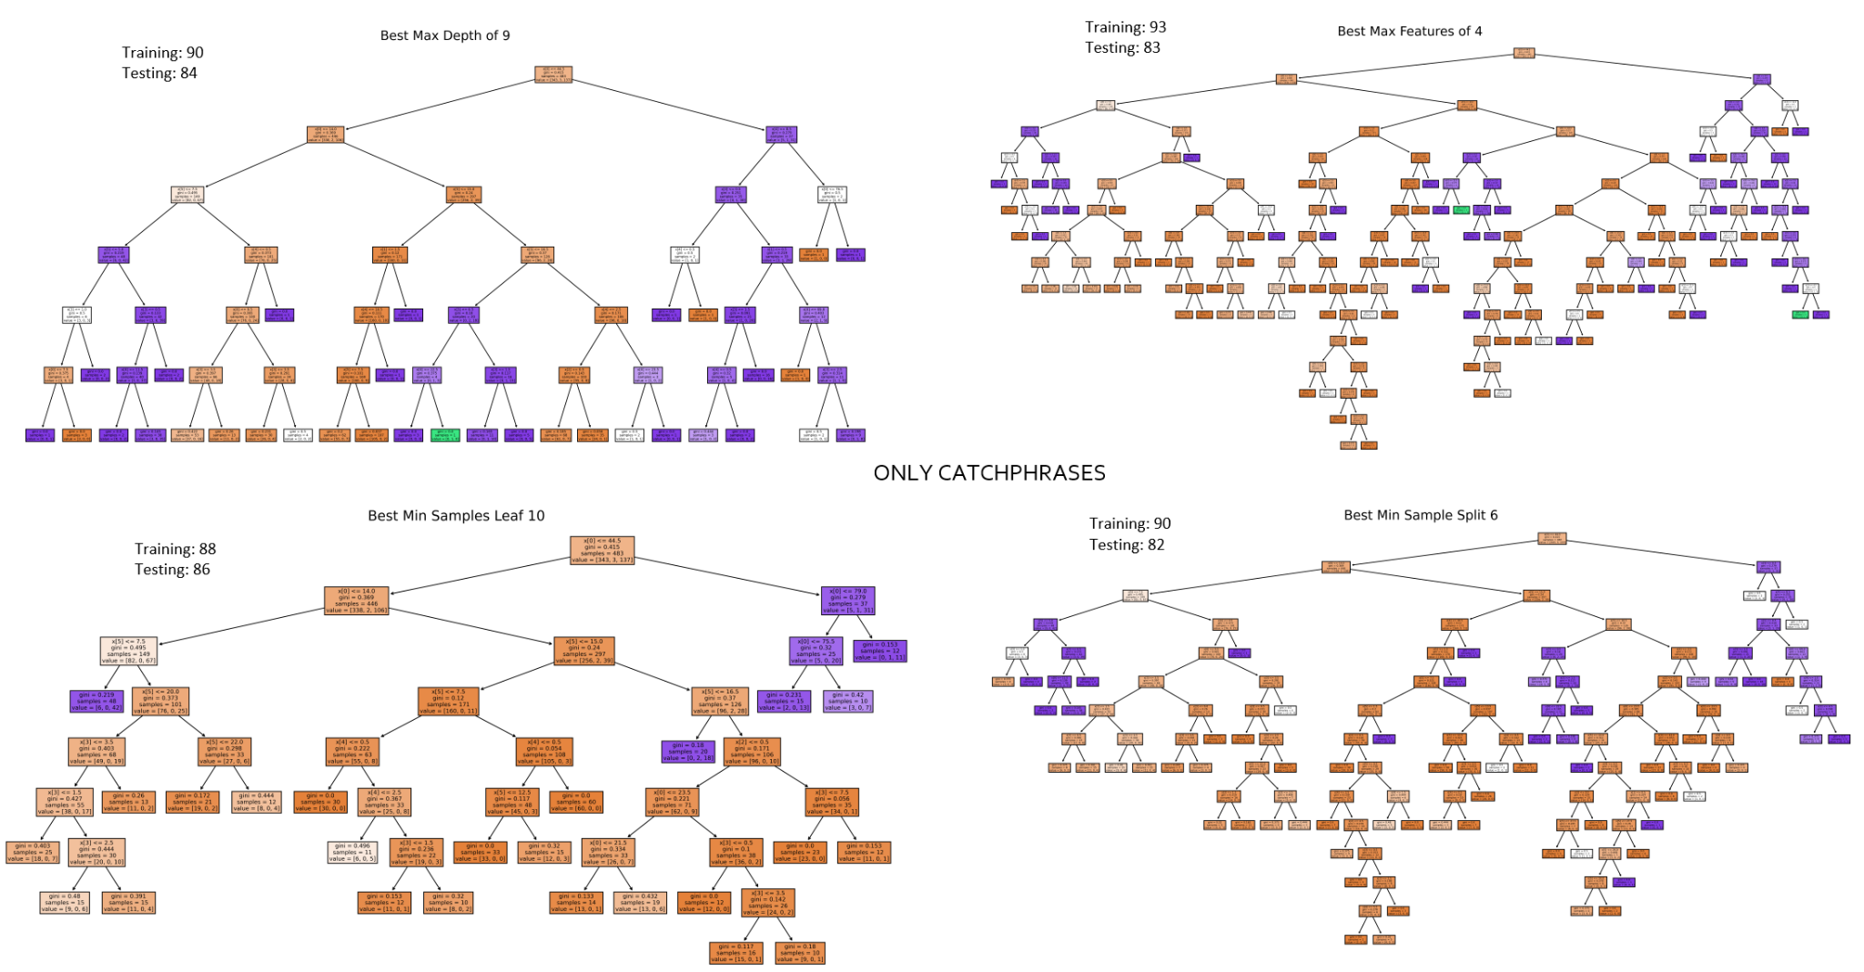
DECISION TREES

Slide 16
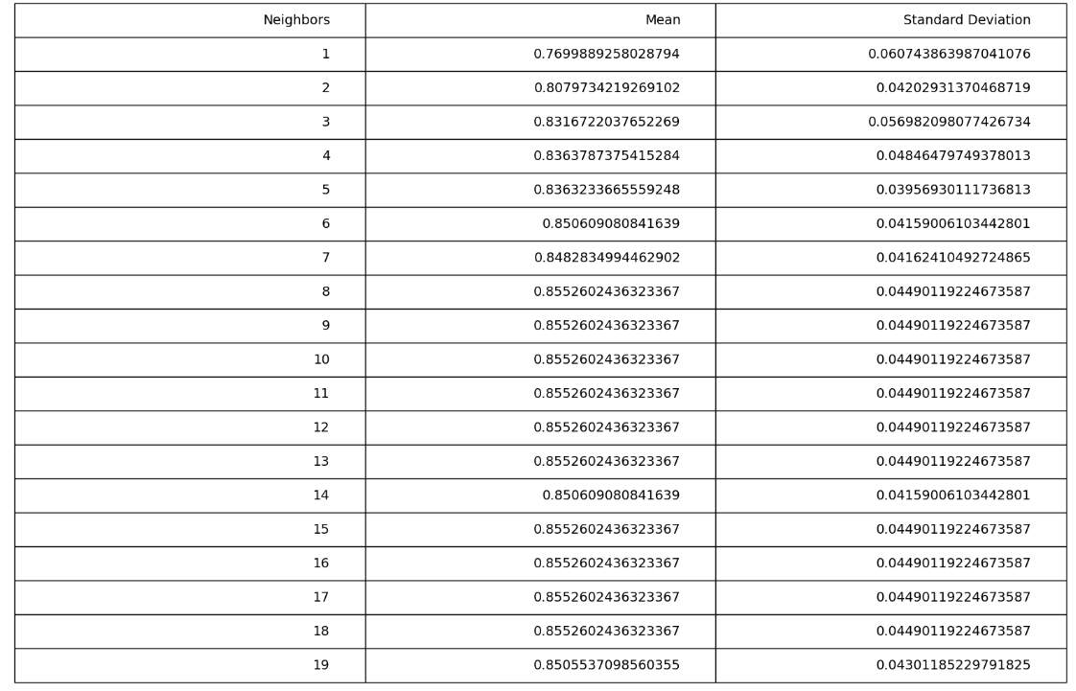
NEAREST NEIGHBORS
Decide how many neighbors to use for K
10-Fold Cross Validation to ensure the model will not give biased scores
K=16 gives the best mean

Slide 17
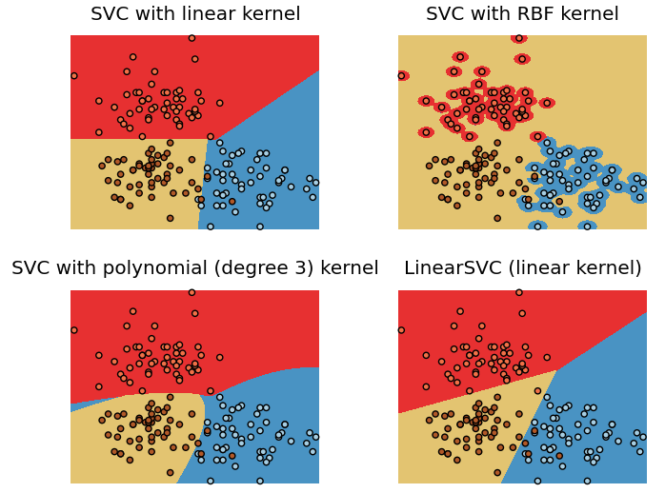
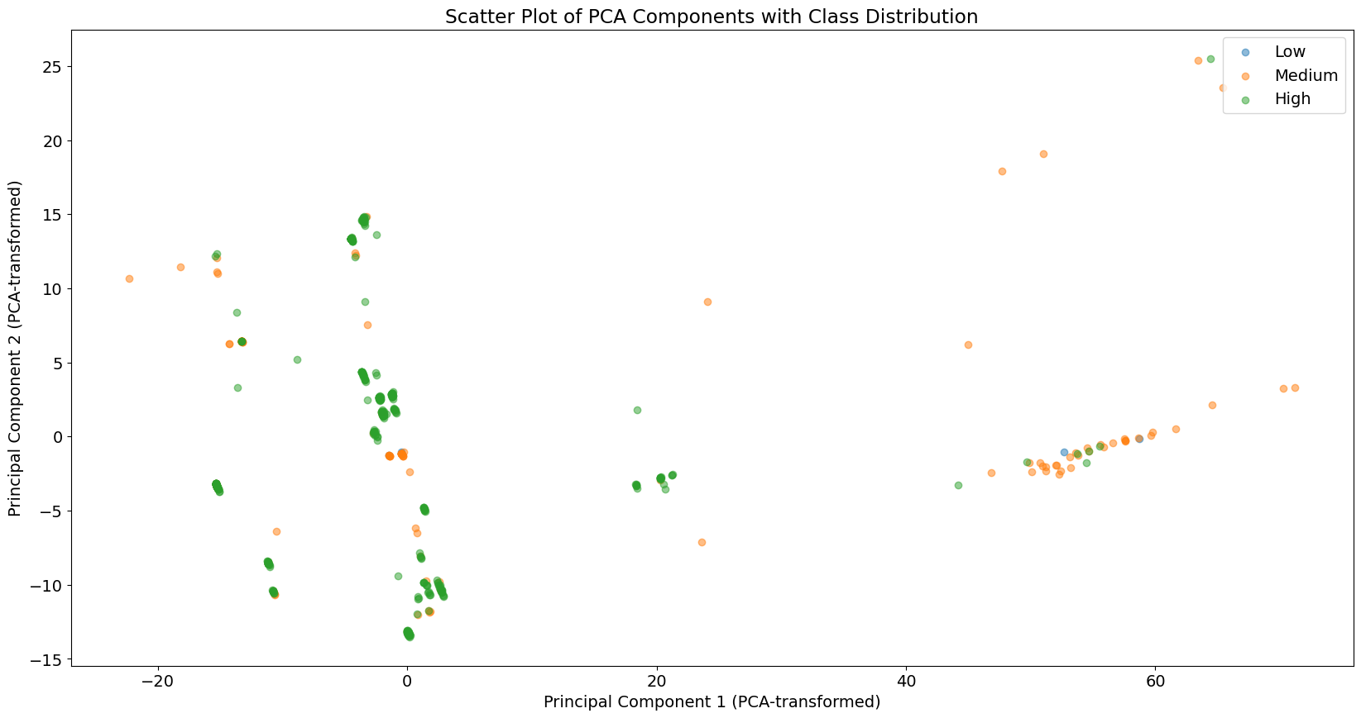
RBF SVM
Hyperparameters:
C
Gamma
Not Linearly Separable
Relatively High dimensions

Slide 18
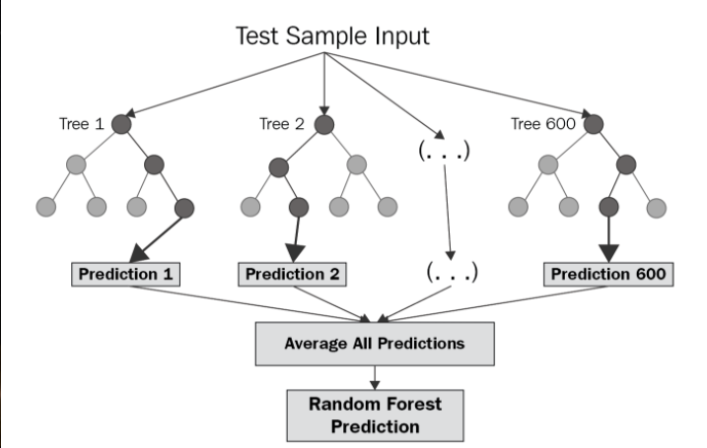
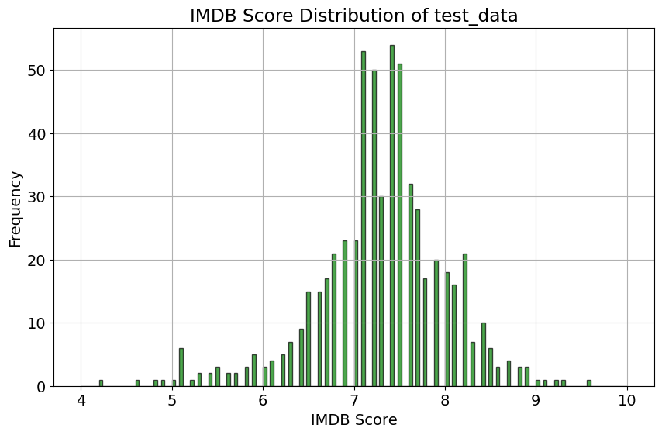
RANDOM FOREST REGRESSION
Hyperparameters:
Number of Estimators
Max depth
Builds multiple decision trees and merges predictions.
Will be harder to predict because more room for error.

Slide 19
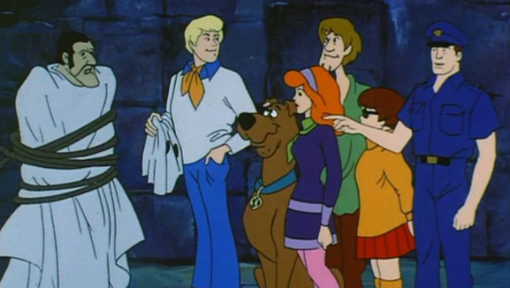
RESULTS &
ANALYSIS

Slide 20
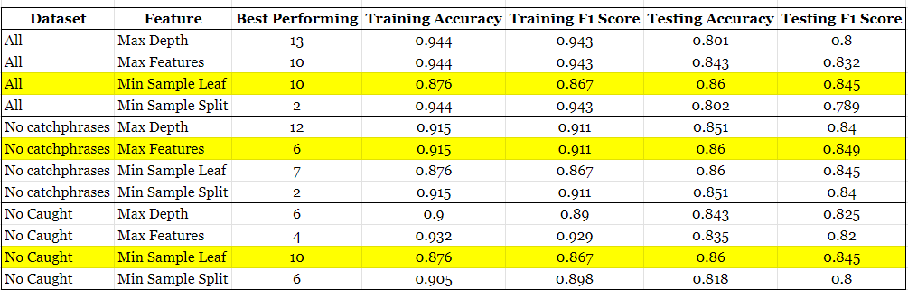
DECISION TREES

Slide 21
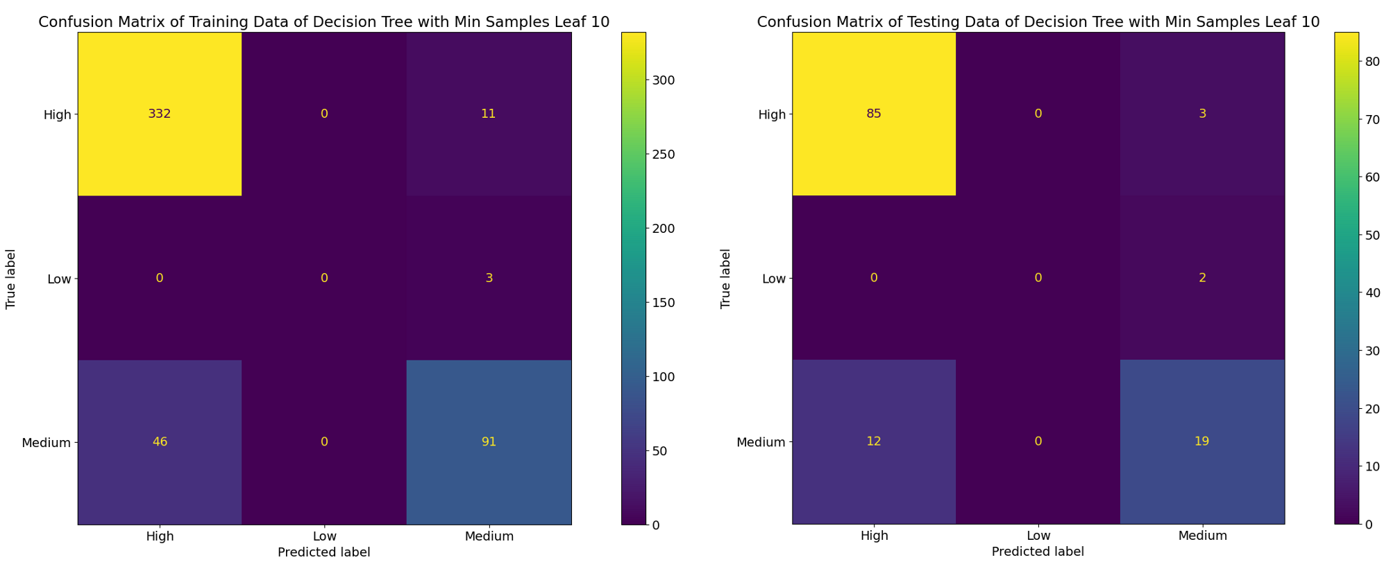
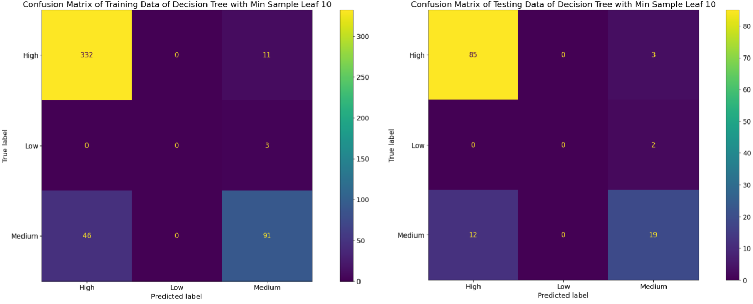
DECISION TREES
Minimum Sample Leaf best hyperparameter for all data & no caught
Training: 88%
Training F1: 87%
Testing 86%
Testing F1:85%
10 Minimum Sample Leaf

Slide 22
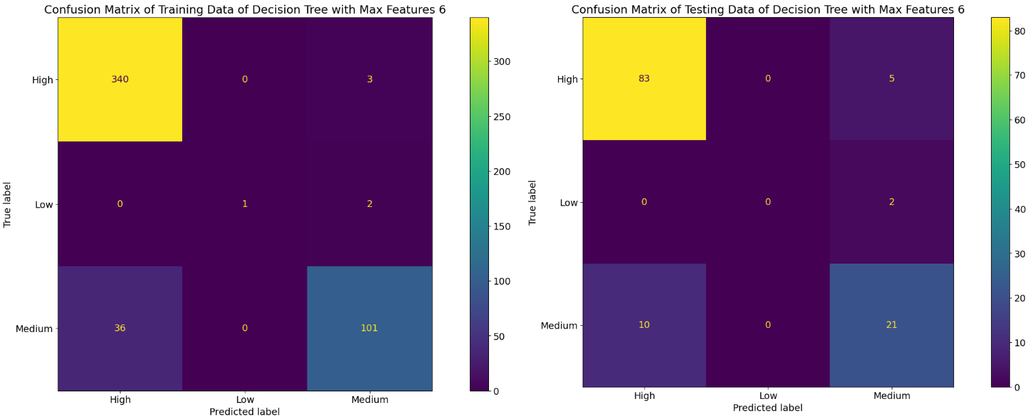
DECISION TREES
Maximum Features best hyperparameter for no catchphrases
Training: 92%
Training F1: 91%
Testing: 86%
Testing F1: 85%
6 Max Features

Slide 23
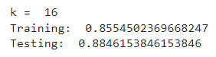
NEAREST NEIGHBORS
Trained with all features
K=16 had the highest testing accuracy score

Slide 24
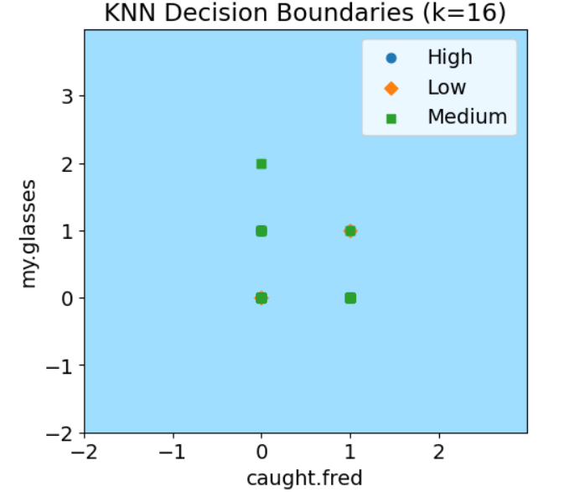
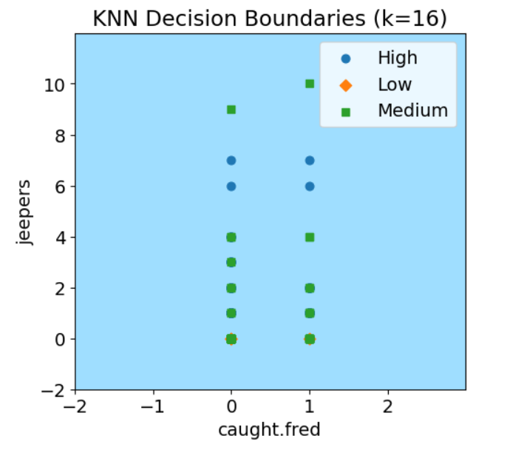
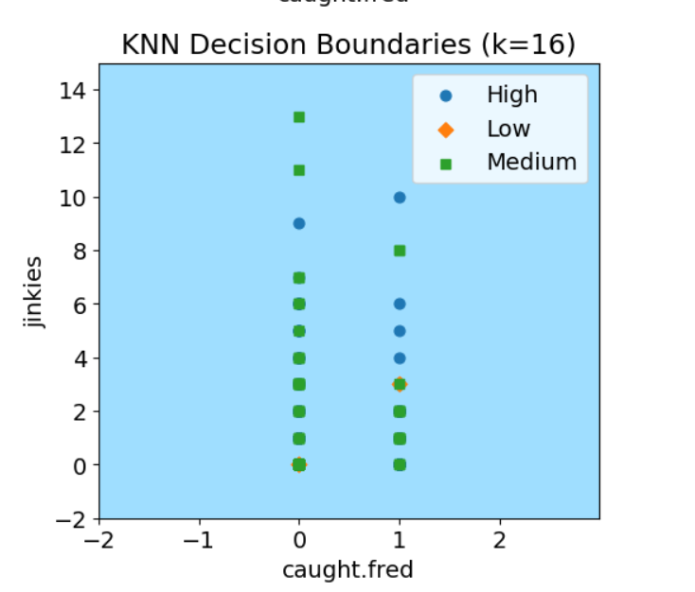
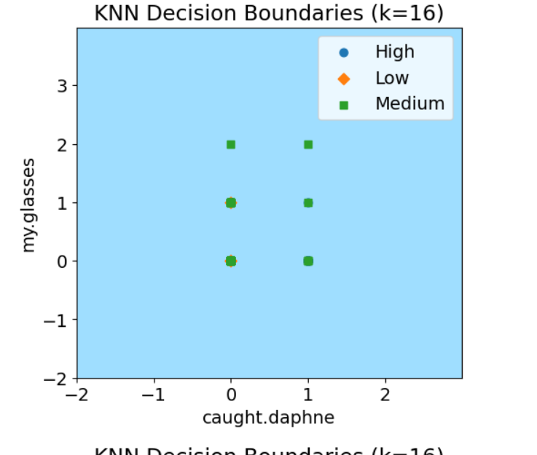
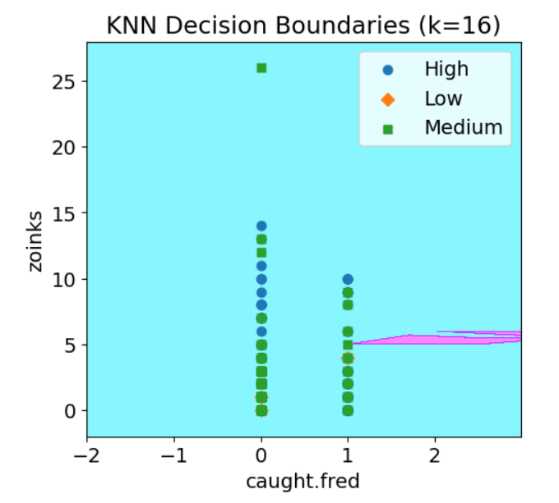
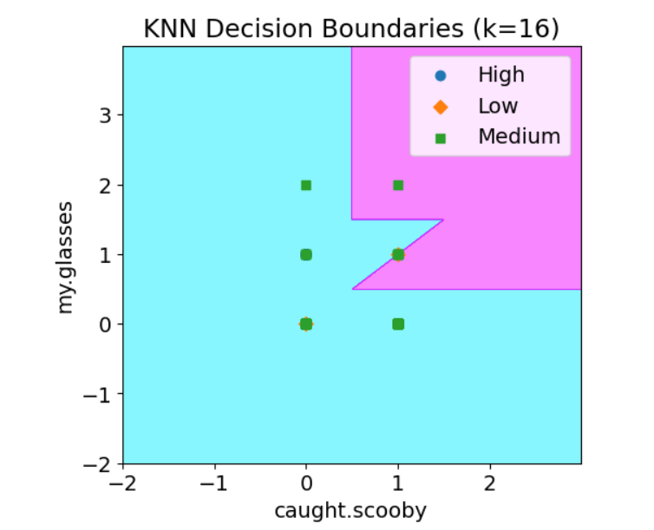
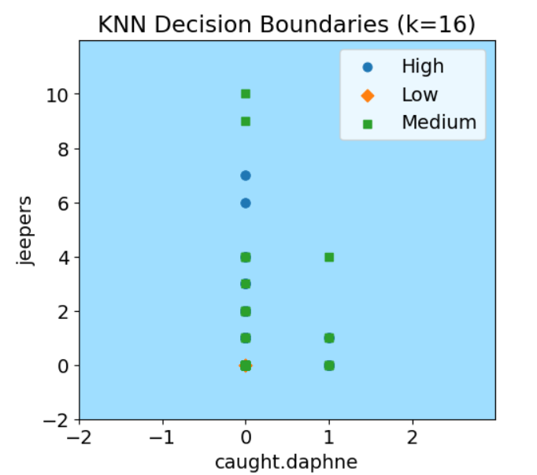
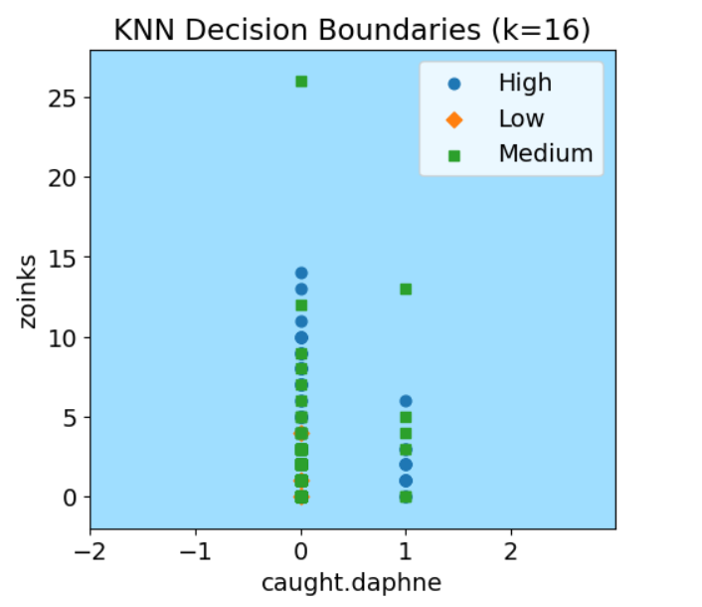
NEAREST NEIGHBORS
Had to compare two features at a time to produce graphs

Slide 25
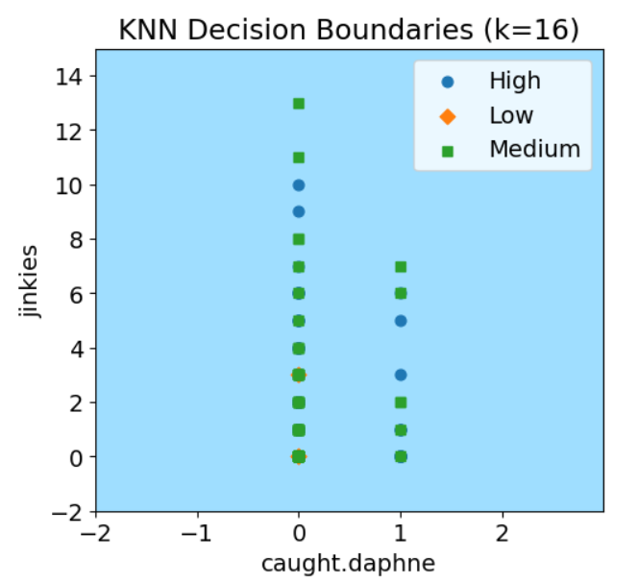
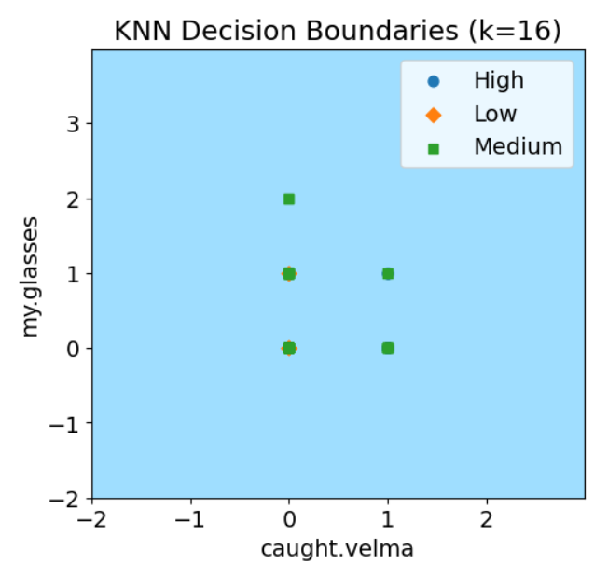
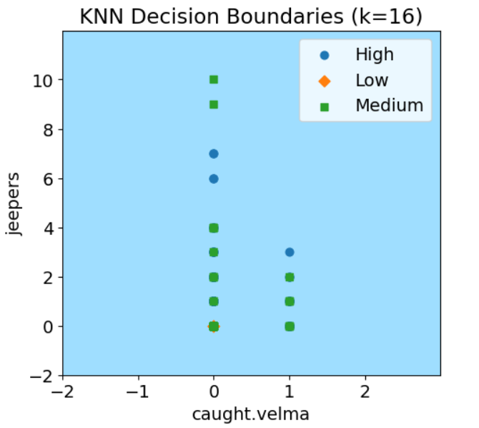
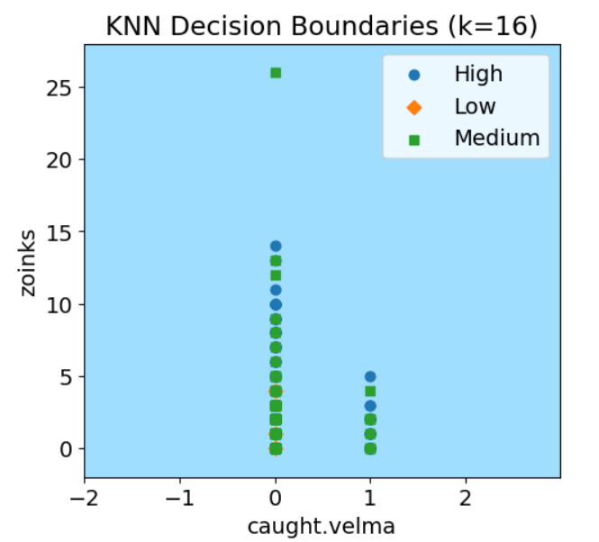
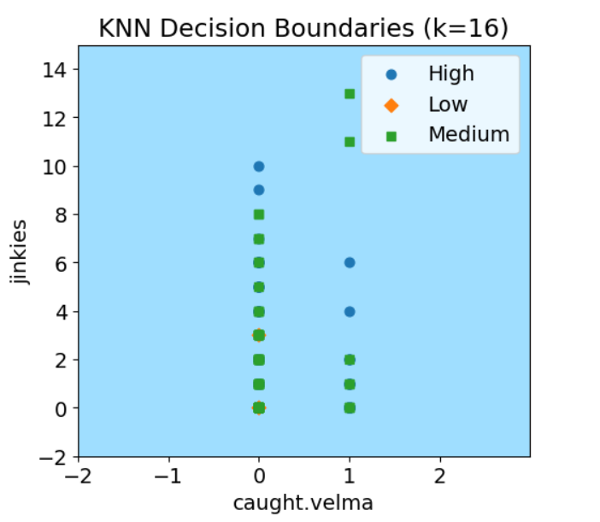
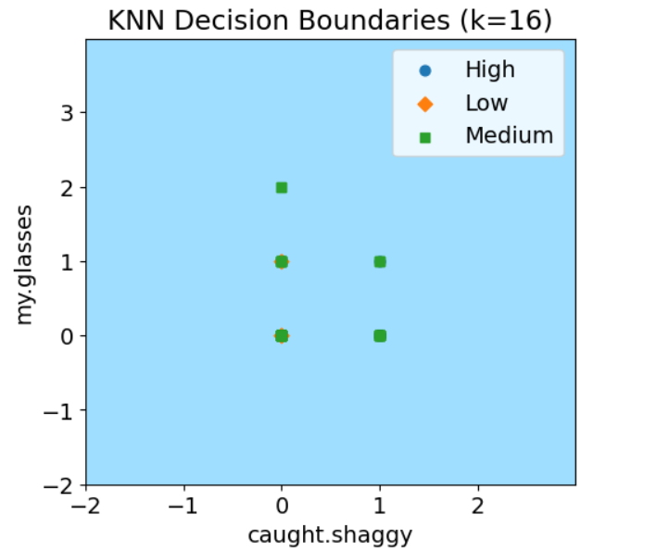
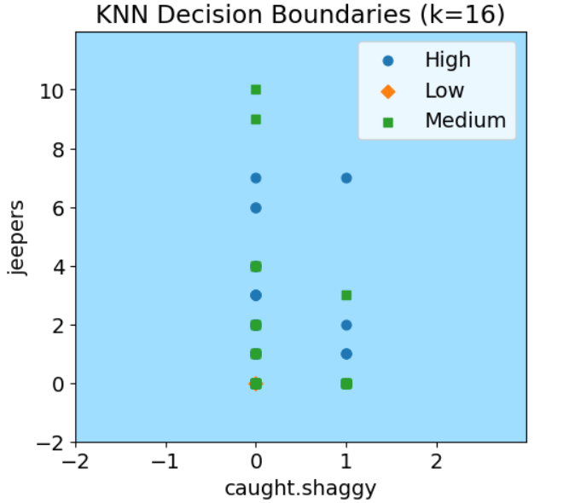
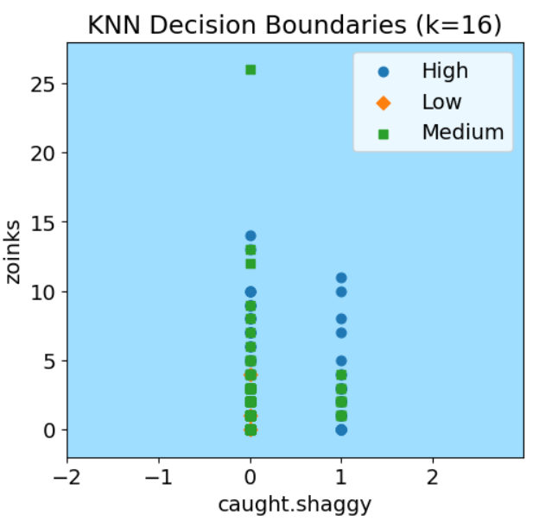
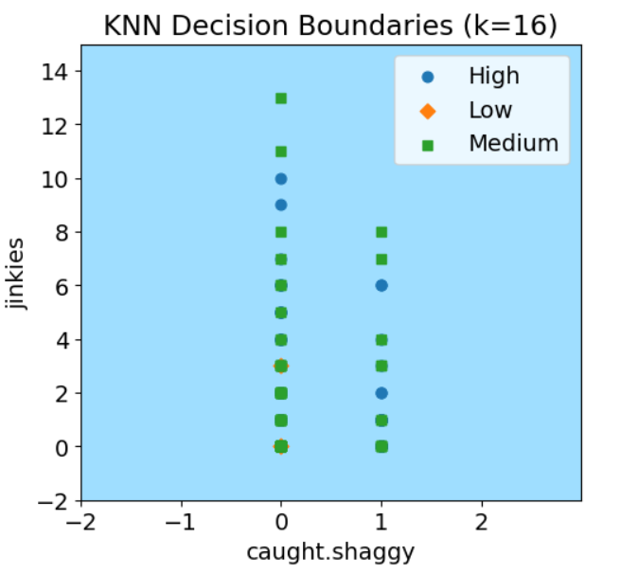
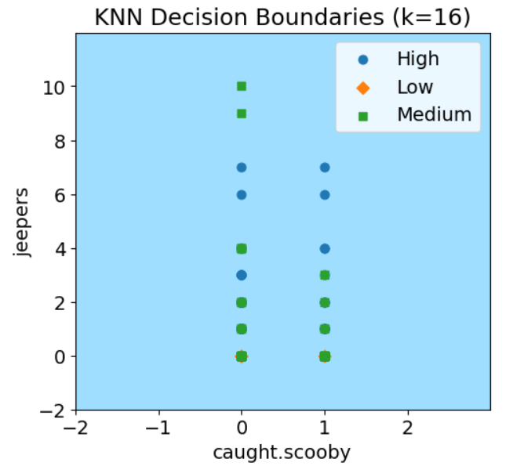
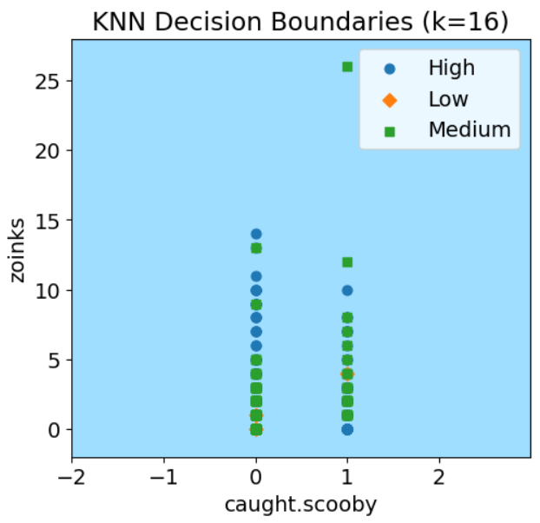
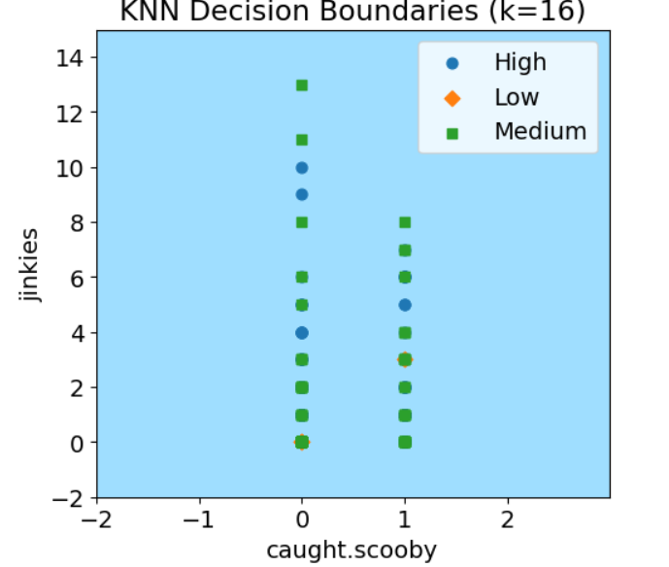

Slide 26
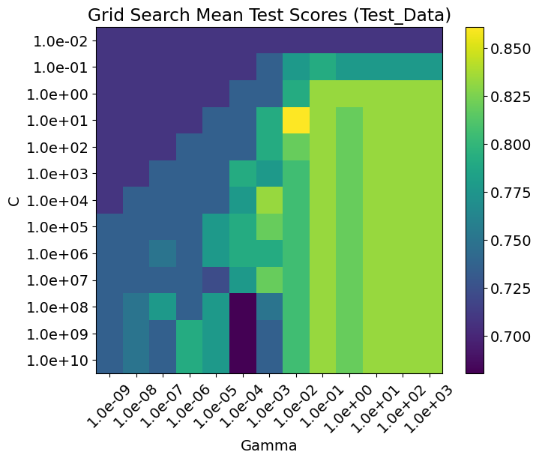
RBF SVM
Hyperparameter Tuning:
(Validation Set)
C - Regularization
Gamma - influence of a single training example
Best Performing: C=10, gamma=.001
Validation Accuracy: .86

Slide 27
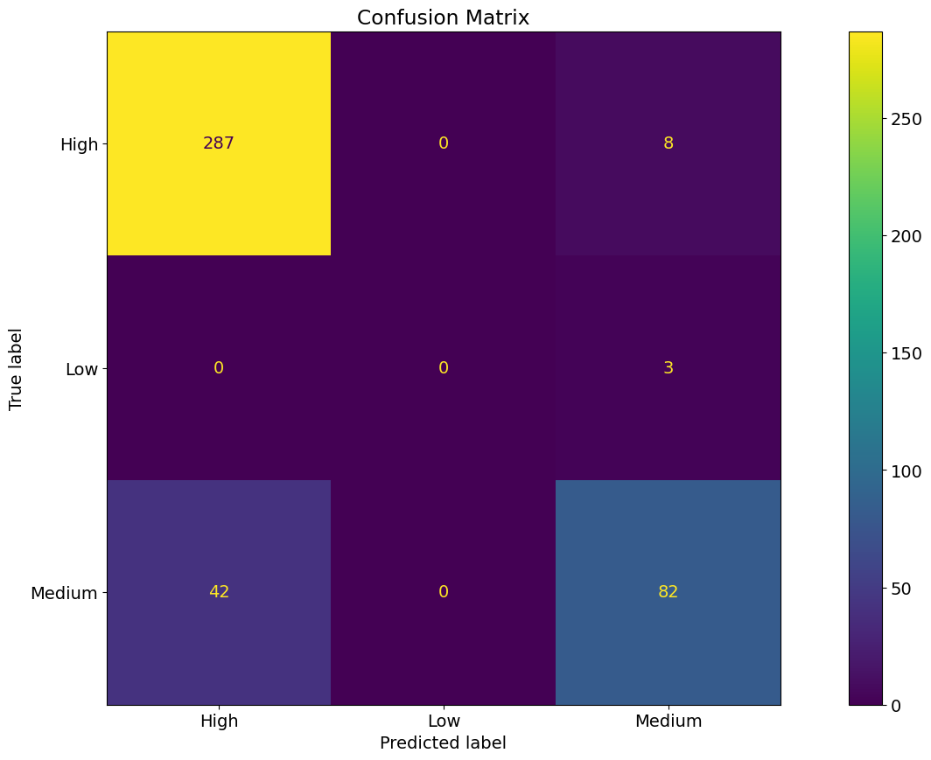
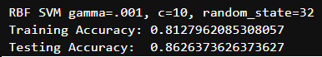
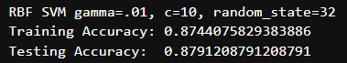
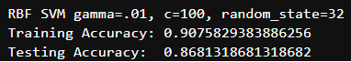
RBF SVM
Results:

Slide 28
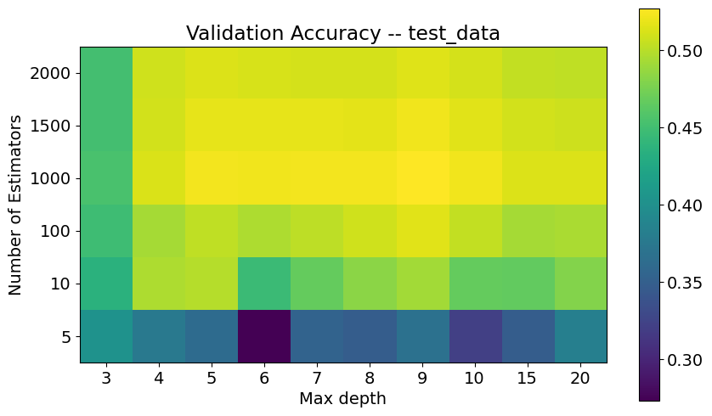
RANDOM FOREST REGRESSION
Hyperparameter Tuning:
(Validation Set)
Number of Estimators
Max depth
Best Performing: N_estimators=1000 max_depth=9
Validation Accuracy: .52

Slide 29




RANDOM FOREST REGRESSION
Results:

Slide 30
DISCUSSION & CONCLUSION
Nearest Neighbors was our best performing ML method
88% accuracy
Why this was best?
Easier for the model to sort into the appropriate bins
Proximity based classification able to capture patterns in the data
Regression underperformed as there was more room for error in predicting continuous values
Decision Trees and RBF were not good at predicting medium bins

Slide 31
Future Work
Analyze different features and their impact on IMDB score
Test new episodes/movies not accounted for in the dataset
For Decision Trees, study impact of multiple hyperparameters
Test different regression models like linear, RBF, poly, and sigmoid SVR. Look more into PCA analysis and oversampling.

Slide 32

Thanks!

